Slide 1

Changing Higher Education through better complaints handling – Surviving and Steering Change
ENOHE 2013
Rob Behrens
CEO and Independent Adjudicator
rob.behrens@oiahe.org.uk
Oxford
Friday, 12 April 2013

Slide 2
Surviving and steering change
Introduction
The Present State: Navigating Regulatory Change while keeping the ship afloat
Mandates and Resources: Must, should, could and can’t
Evidence-Based Approach: Looking out to look in
Strategic Engagement: Prioritising where we are going and how we get there
Afterword

Slide 3

A. The Present State
 | POLICY SHIFT | THE OIA POSITION
The Browne Report | Market principles in fee charging. Oversight by Super-Quango | No to evidence-light, uncosted super-quango
Higher Education White Paper: Students at the Heart of the system CM.8122, June 2011 | Students at heart of system paying raised tuition fees. Legislation for level playing field for public and private suppliers | Yes to level playing field
Technical consultation: a new, fit-for-purpose regulatory framework for the Higher Education Sector, August 2011
Government Response to Consultations, June 2012 | Legislation postponed. Joined-up regulatory partnership to oversee mediated market system including independent OIA. | Yes to joined-up regulatory partnership

Slide 4
Universities and student complaints: the context

Slide 5
Number of complaints received by the OIA

Slide 6
Number of complaints closed by the OIA

Slide 7
What is complained about: 2012

Slide 8
Student satisfaction:
2010-2012 National Student Survey results
Questions |  | 2010 NSS | 2011 NSS | 2012 NSS
 |  | Satisfied
1-4 | The teaching on my course | 83% | 84% | 86%
5-9 | Assessment and feedback | 66% | 68% | 70%
22 | Overall satisfaction | 82% | 83% | 85%

Slide 9
Student satisfaction: complaints handling 2012

Slide 10
Length of university process
Length of process from first proceedings until a decision was given by the university | 2012 | 2009
0-2 Months | 8% | 18%
3-4 Months | 17% | 21%
5-6 Months | 12% | 21%
6-12 Months | 21% | 21%
More Than 12 Months | 34% | 20%

Slide 11
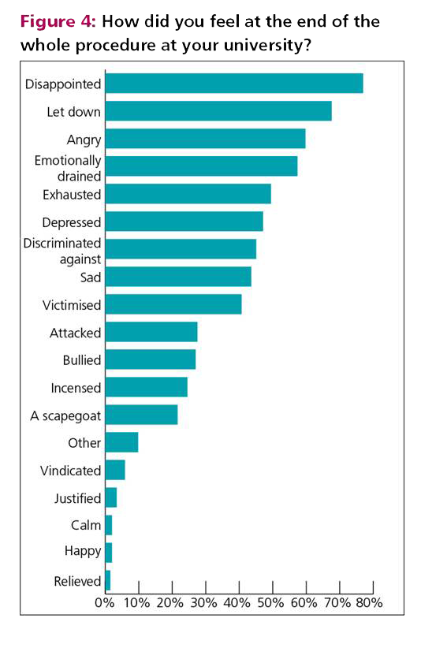
Complainant lived experience of university complaints processes

Slide 12
Impact of institution size on complaint numbers
Number of complaints
Smallest institution
Trendline
Largest institution

Slide 13
Relation between internal complaints and appeals and complaints received by the OIA
Institutions which issued least COP Letters
Institutions which issued most COP Letters

Slide 14
B. MANDATES, RESOURCES AND APPROACH
OIA mandates
OIA is not a Regulator and has no power to:
  Compel HEIs to implement OIA Decisions or
  Fine HEIs
But has powers to:
  Publish details of non-compliance
      Publish summaries of Formal Decisions by name of HEI where there is a ‘public interest’
      Publish Annual Letters to HEIs setting out their complaints handling record
      Share material including Formal Decisions with Regulatory partners with ‘a relevant right or interest’
    Headquarters in Reading, Berkshire. FTE of 55, Budget of circa £4 millions p.a.
2004 Higher Education Act establishes - impartial, independent, adjudication for all HEIs in England and Wales after internal process exhausted
OIA independence set out in Act and Scheme Rules, confirmed by HE White Paper (2011) and by Court of Appeal (Sandhar 2011).
Examines all “acts and omissions” of HEIs beyond admissions, academic judgement and employment issues.
Tests are whether HEI has abided by Regulations and/or whether decision is ‘reasonable in all the circumstances.
Service free to students and former students

Slide 15
Accountabilities/governance
Not for Profit Company Limited by Guarantee
Charity Registered with Charities Commission
Subject to Judicial Review. Nearly 40 challenges to date, mostly unsuccessful.
Constitutional relationship with Secretary of State and Welsh Assembly Minister
Independent Adjudicator appointed under Nolan Rules of fair and open competition for limited terms and independent of Board in all Formal Decisions
Board has majority of independent members recruited under Nolan Rules and minority of directors nominated by HE sector stakeholders
Annual Open Meeting to mark launch of Independent Adjudicator’s Annual Report

Slide 16

C. Evidence-based, consultative approach
On-going consultation programme to develop the OIA itself and the way the sector deals with student complaints
Informs strategic and operational plans
Through:
  Question papers
  Written submissions
  Complainant survey
  Round-table meetings
  Options to choose from
  Routine, regular visits to HEIs and
  students unions
  Learning from other sectors

Slide 17
Sector-wide consultations
Pathway 1 – February 2010
  How to become a service delivery organisation
Pathway 2 – February 2011
  Publication of Annual Letters to HEIs
  Adding more student representation to Board
  Extending Scheme to Further Education Colleges
Pathway 3 – October 2012
  Developing sector-wide Early Resolution of complaints
  Promotion of Good Practice Framework
  Revisions of Funding model

Slide 18
Becoming a service delivery organisation – Pathway implementation
Theme | Key Actions | Implementation
 |  | Pathway:
 |  | 1 | 2 | 3
Mandates | Extend Scheme to Non-Qualifying Institutions Extending Scheme to FECs running Foundation Degrees More effective dissemination of mandates and Rules
Independence | New procedure for service complaints Change of Quorum Rules
User Perspective | Additional Student Board member Revision of Scheme Application Form, OIA literature, and Guidance on Completion of Procedures and Eligibility Review of Disability Policy and Practice
Proportionality, Efficient and Effective Approaches | Development of electronic transactions Review of ‘first contact’ engagement with complainants and develop Early Resolution Review and Revise Funding model
Transparency | Consult on how to publish Formal Decisions. Publish core information about individual HEI record on complaints.
Quality Outcomes | Publish indicative guidance on Remedies Review compliance arrangements Develop written good practice guidance
a
a
a
a
a
a
a
a
a
a
a
a
a
a
a
a
a
a
a

Slide 19
D. STRATEGIC ENGAGEMENT
Defining Mission and Vision builds on analysis of Present-State, Mandates and Resources, and Evidence-based approach.
2013 Mission
Contributing to high quality student experience by the independent and impartial adjudication and resolution of complaints. And promoting good practice in complaints and appeals handling.
2013 Vision
By 2015 recognised as a key driver of high quality student experience through: exemplary dispute resolution of student complaints; the dissemination of a sector-wide good practice framework for complaints and appeals handling in universities; and effective contribution to the risk-based regulatory framework of higher education.

Slide 20
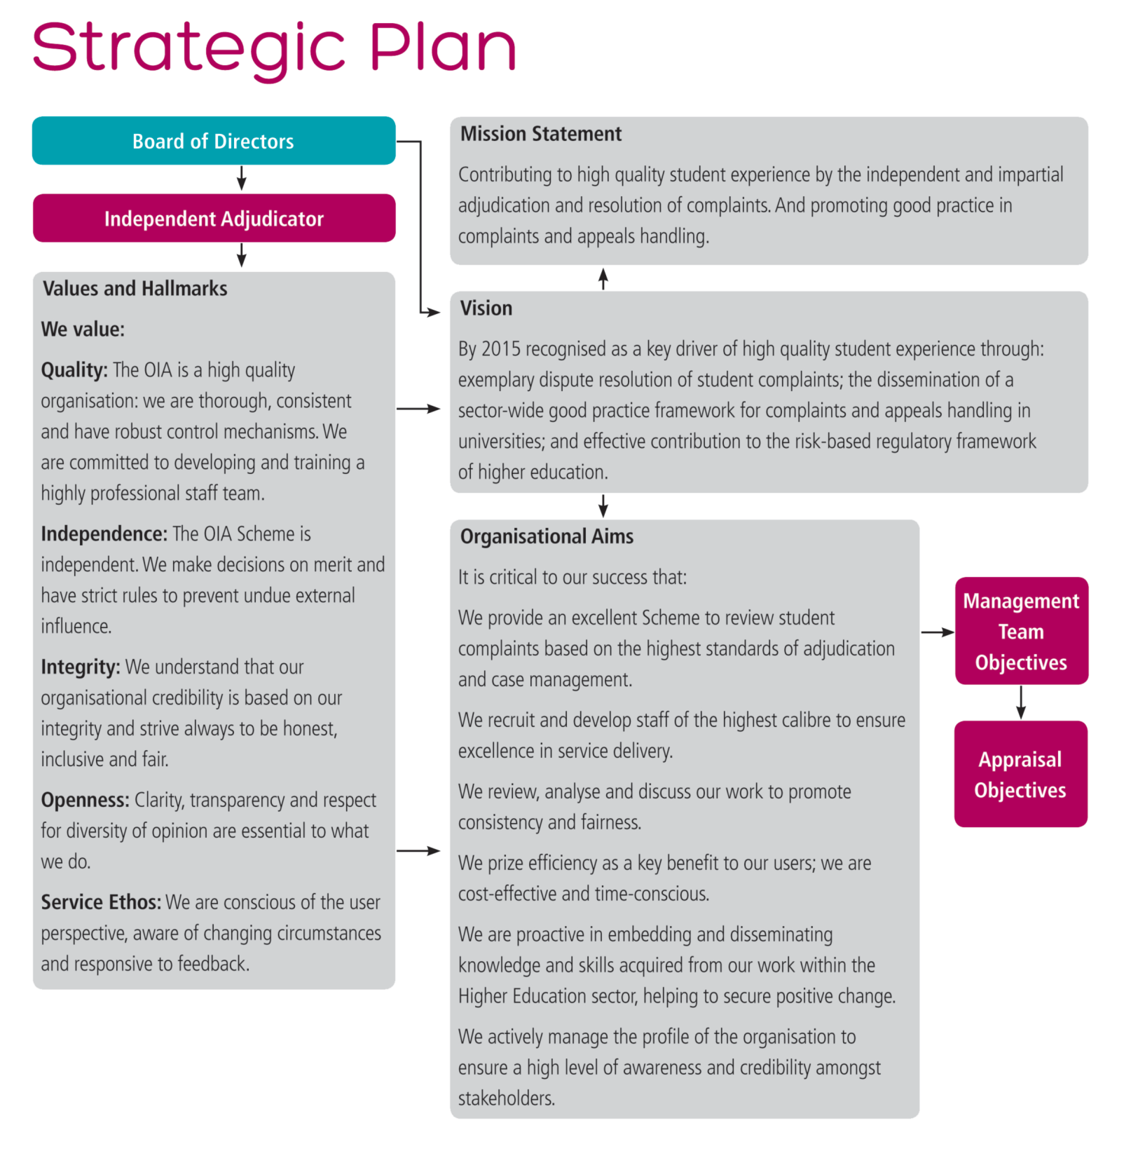

Slide 21
The OIA as a strategic partner (1)
SEVEN STEPS TO EXCELLENCE
“We must improve” Roberto Mancini
(1) A Classic Ombudsman Scheme – Final resort, independent, impartial, complaints resolution for all HEIs in England and Wales. Faster, cheaper alternative to Courts – 10,000 cases closed since inception.
(2) With more Authority than Power – HEIs disciplined at implementing OIA Formal Decisions not limited to financial compensation and Scheme carrying confidence of the student movement
(3) Sensitive to exceptionalism of Higher Education - narrow academic judgement decisions excluded from remit confirming that (i) higher education not a perfect market place, (ii) that students are not ‘customers’ in the allocation of degree outcomes, and (iii) that academic judgement is not whatever an academic thinks, writes or speaks.
(4) Efficient and Effective returning successive annual increases in case closures at lowering unit costs. Generated by significant business process reforms to create Early Resolution through Triage, Mediation and Settlement
(5) Use of Transparency to generate scrutiny, understanding and Public Trust. Publication of Annual Letters to each HEI, and public interest cases by name of University (but not the student) de-mystifies a hitherto arcane process
Decentralisation of responsibility for case decisions – risk based Approval and Management (Early) Assessment Team developed and expanded to assess Eligibility Triage and Settlement Processes to resolve cases as early as possible Targets for monthly closures Element of Outsourcing

Slide 22

The OIA as a strategic partner (2)
(6) Member of the Regulatory Partnership Group, sharing material with partners to manage sector risks.
(7) Engine of Good Practice sharing to improve professional standards (and the student experience) in face of HE cultural norms sometimes unsympathetic to ‘due process’ and corporate action. Key current issues are (eg) Academic Misconduct, Post-Graduate Supervision, development of a Good Practice Framework and Early Resolution
THE WOOLF INQUIRY An inquiry into the LSE’s links with Libya and lessons to be learned OCTOBER 2011 “However difficult to express, there are different parameters of permissible assistance, and they should not remain unwritten. “

Slide 23
The OIA as a strategic partner: Early Resolution Pilots and after
Principles of Early Resolution Initiative
Impractical to graft on to English and Welsh HEIs a campus ombudsman concept which sits uneasily with existing arrangements, not available at European universities.
Diversity of approaches and record of achievement of a number of existing bodies in supporting students with complaints
  Student Services Offices
  Students Union Advice Centres
  Student Conciliators
  Graduate Interns
  Complaint Mediation Schemes
Mediation – an under-used and not always understood process in HEIs
No one size fits all
Canterbury Christ Church – wider use of mediation
Glamorgan – Student Conciliators
Sheffield – facilitated discussion
Kingston – training in complaint handling and mediation
Huddersfield – student conciliators
ARC linking pilots to good practice procedure
Good Practice Framework (from 2014)
  OIA-led, non-regulatory, consultative, sector wide, written operational guide on complaints and appeals to concretise QAA Quality Code.

Slide 24

AFTERWORD
The Hobsbawm Fallacy – ‘Why I am right about everything’.
Johari’s Window – know what you don’t know
Keeping Afloat is not the same as heading to port.
Regulators and quasi-regulators need to understand the sector they work in.
Impartiality and independence are not barriers to dialogue and conversation
Learn from the mistakes and successes of others
Institutional purity is less important than positive outcomes for complainants with legitimate grievances.
“For England Expects — I forbear to proceed.
Tis a maxim tremendous, but trite.
And we’d best be unpacking the things we need
To set ourselves up for the night.“
Lewis Carroll, The Hunting of the Snark, 1876

