Slide 1
10th Annual Conference European Network for Ombudsmen in Higher Education (ENOHE)
St Catherine’s College
Oxford University
April 11th-13th, 2013
Spencer Boudreau PhD
McGill University
ombudsperson@mcgill.ca
Me Nancy Chamberland
Laval University
Nancy.chamberland@ombuds.ulaval.ca

Slide 2
The Maple Spring in Québec
In 2012 an increase in University tuition by the Liberal Government resulted in massive student protests.

Slide 3
Historical background
Canadian Federalism:
Education is under provincial jurisdiction
In and for each Province the Legislature may exclusively make Laws in relation to Education (The Constitution Act , 1867)
1960’s - beginning of Québec’s Quiet Revolution:
Ministry of Education established in 1960

Slide 4
University Education in Québec
17 universities (3 English)
272,011 students
9,448 full-time professors
University of Québec established in 1968 with several campuses across the Province

Slide 5
Tuition Fees (before increase)
Québec residents: $2168 (excluding student services fees) or $72.26 per credit
Non-Québec residents pay more, e.g. a student from Ontario studying in Québec pays $5858.10

Slide 6
Tuition Hike
Original proposal: an increase of $1635 over a five-year period
Last offer: an increase of $1533 over a seven-year period
Tuition hike proposals resulted in massive student protests

Slide 7
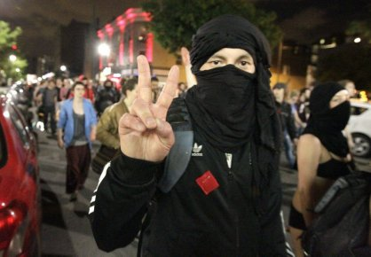
Student Protests
http://www.youtube.com/watch?v=p89zmzpa2mE

Slide 8
Bill 78
Liberal government passes a law that ensures students are not denied entry to their college or university.
It also restricted picketing and required demonstrators to inform police of protest venue.
New law resulted in more protests with the support of labour unions.

Slide 9
Québec Provincial Election- Sept. 4, 2012
Liberal government of Jean Charest defeated
Election of Parti Québécois (minority government)- Premier Pauline Marois
Planned tuition increases repealed
Plans for Education Summit announced

Slide 10
Proposals
Tuition hike
Free Education
Freeze
Indexation
Modulation

Slide 11
Education Summit: Feb. 25 _26, 2013
Government decides to increase tuition by 3% ($70 annually).
Student associations that attended (one student association boycotted summit) more resigned than happy.
University administrators greatly disappointed “System is anaemic” (G. Breton, U. de M.).

Slide 12
Protests Continue
http://www.youtube.com/watch?v=kL-XRaMnrgQ

Slide 13
Role of Ombudspersons?
Do individual ombudspersons or associations have a public role to play regarding issues such as tuition increases, accessibility for all despite financial obstacles, the goals of education, the role of universities, etc?

Slide 14
MERCI!

