Slide 1
@enohe13
#enohe13

Slide 2
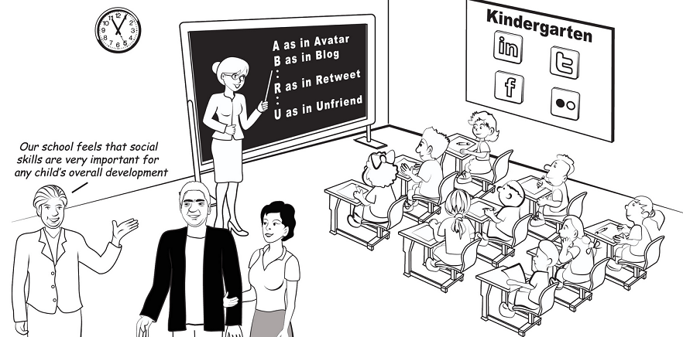
Social Networking
“We don’t have a choice on whether we do social media, the question is how well we do it.”
– Erik Qualman

Slide 3
Social Networking – the Stats
Facebook
Twitter
Linked In
Users (global)
Users (UK)
Interactivity (global)
Unique visits
Web Ranking
1 bil +
32 mil +
500 mil + likes p/day
167 mil p/month
2nd
500 mil +
34 mil +
340 mil tweets p/day
39 mil p/month
11th
200 mil +
10 mil +
50 mil p/month
13th

Slide 4
Social Networking & the OIA
We currently have 3 official ways of communicating via social media
Twitter (@oiahe) being our most popular way of communicating to key stakeholders;
Currently have 750 followers ranging from key stakeholders, to students’ unions.
Potential to use more for enquiries but has challenges.
Linked In – Very new company page recently set up. Potential to use for employment and sharing news.
Facebook – Underused due to the nature of the site.

Slide 5
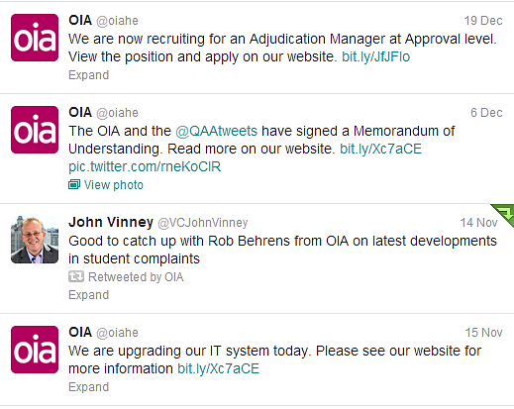
Social Networking & the OIA
Examples of uses the OIA use for Twitter
Recruitment
News & PR
Re-tweeting relevant and positive tweets/information
Office information
Events & workshops

Slide 6
Social Networking – Pro’s & Con’s
The Good :)
Speed of publications - Quick and easy way of sharing news, views and any other company information.
Specific audience reach - People who follow the account are genuinely interested in what you have to say and the content involved.
Good for PR - Keeps everyone in the loop of what is going on
Keeping up-to-speed with the latest news in higher education and monitor any activity mentioning us.
The Bad :(
Vandalism – people who intentionally go out of their way to hurt the credibility of the company.
In the Spotlight – Tweets need to be well thought out before sent, as people pick up on mistakes or anything that may favour bias.
The Challenges :S
Tweets from complainants – Should we reply? Data protection issues? Log it on our complaints system?
Keeping the professionalism and independence

Slide 7
Social Networking – Looking ahead
What is the future for the OIA and Social Media?
Can we answer back any general enquiries?
Can we take complaints?
How are we going to communicate in the future?
What are we going to do about ‘trolls’?
How can we adapt alongside the ever changing social media landscape?
We can answer these questions with a social media strategy.

Slide 8
Social Networking and universities
Many students use social networking extensively
Increasing use by universities
marketing: help to build the ‘brand’
promote student engagement
as a forum for complaints?
OIA examples of complaints involving social networking issues
Issues affecting complaints handlers

Slide 9
OIA examples: disciplinary issues
Forensic science students photographed themselves holding human bones
Photographs posted on Facebook and picked up by local newspapers
Inappropriate staff response on Facebook
Applicability of university’s disciplinary procedures
Different roles played by the students led to different penalties

Slide 10
OIA examples: disciplinary issues
Student commented about his nursing course in an on-line blog (did not name individuals)
Student withdrawn from course following ‘fitness to practise’ proceedings and referred to the relevant professional body (the NMC)
NMC determined was ‘no case to answer’
‘Professional elements’ of vocational courses
Codes of conduct published by professional bodies
OIA rejected student’s complaint that penalty imposed by university was too harsh

Slide 11
OIA examples: bullying and harassment
Student A made unpleasant comments on Facebook about Student B and Student B complained
Comments in Chinese and on page with tight privacy settings (but Student B was Facebook ‘friend’ of Student A)
University determined was not harassment
BUT on-line translation tool freely available AND test was ‘did [Student B] experience unwanted behaviour which she found to be offensive or intimidating’

Slide 12
OIA examples: bullying and harassment
Student posted a video of himself on ‘You Tube’ in which he described a university tutor in inappropriate language
Found to be in breach of university’s disciplinary code and told to remove video
Video re-appeared on another website
Student claimed it had been placed there by another person and that he could not remove it
Student withdrawn from university

Slide 13
OIA examples: other issues
Student complained about accommodation issues and produced Facebook screenshots showing that other students had also had concerns
Data protection issues
Use of social networking by university staff
Student alleged that university’s senior administrator was ‘unprofessional’ (relying on evidence from Facebook) and so was not fit to consider her complaint

Slide 14
Issues affecting the complaints handler
‘Stalking’ by complainants through social networking media
Invitations to become a Facebook ‘friend’ of complainant
LinkedIn requests
BEWARE viewing LinkedIn profiles of complainants when logged in to own LinkedIn account
On-line blogs and websites mentioning OIA staff

