Slide 1
HIGHER EDUCATION OMBUDSMEN AND EMPOWERMENT
EMPOWERMENT, PUBLIC TRUST AND THE OMBUDSMAN
Rob Behrens
“People were most suspicious when I called ...I had to feel my way , exchanging trust for trust’. District nurse, practising in rural Norfolk, quoted in Ronald Blythe, Akenfield, 1968.
“Comrades! The first principle of the Revolution is effective time-keeping.” - Govan Mbeki, after being released from Robben Island after 25 years.
Chief Executive and
Independent Adjudicator
Robert.behrens@oiahe.org.uk
Twitter @OIAChiefExec
ENOHE ANNUAL CONFERENCE, WARSAW, POLAND
15-17 MAY 2014

Slide 2
ON MY WAY TO WARSAW
ENOHE 2008-14
Experience of transitions to democracy – “we know you are reactionaries. Tell us your experience.”
Experience of Civil Service and Legal Services
OIA is classic Ombudsman scheme, established under 2004 Act to resolve student complaints after internal processes exhausted.
Free to students
Tests used.
With experience of resolving 10,000 cases
Subject to Judicial Review – ‘no reasonable person’
The EU Directive

Slide 3
EMPOWERMENT
“Empowerment is the process of enhancing the capacity of individuals and groups to make choices and to transform those choices into desired actions and outcomes.” (Adapted from World Bank).
Central to this process are actions which build individual and collective assets in a way which improves efficiency and fairness in interventions.

Slide 4
RELEVANT INDIVIDUALS AND GROUPS: UNIVERSITIES

Slide 5
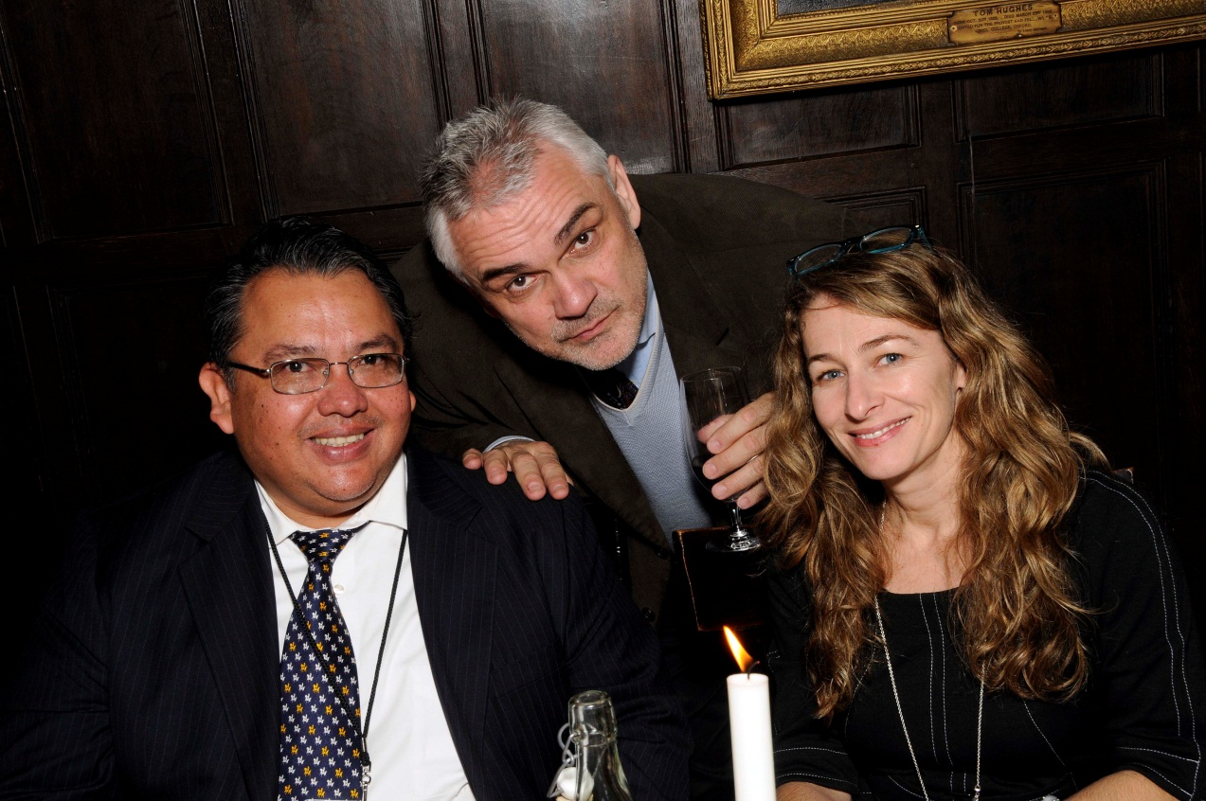
RELEVANT INDIVIDUALS AND GROUPS: HIGHER EDUCATION OMBUDSMEN/PERSONS

Slide 6
RELEVANT INDIVIDUALS AND GROUPS: STUDENTS.
Cartoon by Cameron Law

Slide 7
KEY ELEMENTS OF EMPOWERMENT
Access to Information
Inclusion and participation
Accountability
Local organisational capacity.
And consequential risks...

Slide 8
RISKS IN EMPOWERMENT
Information is power and motivation to act. EG. social media empowers users (especially students) to unite in campaigning
Participatory decision-making is rarely harmonious and leads to contested views of priorities and needs. Conflict is endemic.
Accountability which calls service providers to account elicits accusations of ‘washing dirty linen in public’ and reputation damage
Cartoon by Cameron Law

Slide 9
MITIGATING THE RISK : PUBLIC TRUST
What engenders Public Trust ?
Key elements include:
Perceived honesty and independence of profession
Development of internal culture fostering standards and openness to improve professional integrity and increase confidence in public institutions
Exhibits a core competence in serving users
Manifestation of ‘trustworthy’ behaviour

Slide 10
A BURNING PLATFORM OF TRUST ?

Slide 11
THE CRISIS OF TRUST
Ministers and conflicts of interest (1998-2004)
Systematic, widespread, mis-use of expenses by MPs (2009-10)
Mis-selling of goods and services by banks (2001-8)
Illegal telephone hacking by newspapers (2005-11).
Failure to investigate avoidable deaths in hospitals (2008-12)

Slide 12
WHAT WE LEARN (1)
Public Trust is variable depending on perceptions of independence and honesty. Trust in higher education is currently high.
Trust ratings are susceptible to collateral damage.
IPSOS MORI (1983-2013) 2011
Do you ‘generally trust them to tell the truth or not?’ (%)
Doctors 88 Teachers 74 Professors 74 Judges 72 … Police 63 Ordinary person in street 55 … Civil servants 47 Journalists 19 Government ministers 17 Politicians generally 14

Slide 13
WHAT WE LEARN (2)
Scandals occur where independent oversight is either non-existent, imperfect or constrained.
At the start of many ‘scandals’ is a detriment to a person.
Codes of Practice which carry authority are key to sector integrity.
Transparency is an aid to perceptions of independence and to good practice.
The inter-personal becomes the strategic. Trustworthy behaviour is required on all sides and needs dialogue with newly empowered. (students empowered by social media).

Slide 14
SEVEN STEPS TOWARDS ETHICAL EMPOWERMENT empowerment + search for trust = ethical empowerment
Core competence (‘doing what you say you will do’)
Centrality of Good Practice Codes
Learning from outside higher education
Learning from inside higher education
Transparency engenders Trust as well as empowerment
Towards being a profession – but not on any terms.
Trustworthy behaviour concretised .

Slide 15
COMPETENT DELIVERY
Increasing front-line capacity
Responsibility for case approvals and management decided following a risk-based approach
(Early) Assessment Team developed and expanded to assess eligibility and explore settlements
Triage and settlement processes to resolve cases as early as possible.
Targets for monthly closures
Targets for unit costs.
“Comrades! The first principle of the Revolution is effective time-keeping.” - Govan Mbeki, after being released from Robben Island after 25 years.

Slide 16
GOOD PRACTICE CODES

Slide 17
TRANSPARENCY RULES
“Transparency certainly destroys secrecy: but it may not limit the deception and deliberate misinformation that undermine relations of trust. If we want to restore trust we need to reduce deception and lies rather than secrecy.”
Onora O’Neill, A Question of Trust: The BBC Reith Lectures , 2002.

Slide 18
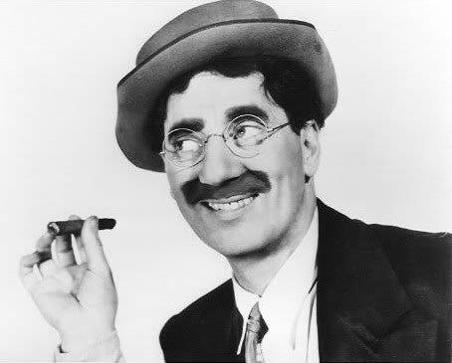
TOWARDS BEING A PROFESSION ?
IOA CODE OF ETHICS
PREAMBLE The IOA Code of Ethics provides a common set of professional ethical principles to which members adhere in their organizational Ombudsman practice.
INDEPENDENCE The Ombudsman is independent in structure, function, and appearance to the highest degree possible within the organization.
NEUTRALITY AND IMPARTIALITY The Ombudsman, as a designated neutral, remains unaligned and impartial. The Ombudsman does not engage in any situation which could create a conflict of interest.
CONFIDENTIALITY The Ombudsman holds all communications with those seeking assistance in strict confidence, and does not disclose confidential communications unless given permission to do so… [except] where there appears to be imminent risk of serious harm.
INFORMALITY The Ombudsman, as an informal resource, does not participate in any formal adjudicative or administrative procedure related to concerns brought to his/her attention. [emphasis added]
‘I refuse to join any club that wouldn’t have me as a member.’ Adapted from Groucho Marx

Slide 19
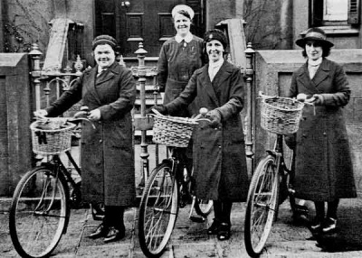
TRUSTWORTHY BEHAVIOUR
“People were most suspicious when I called ...I had to feel my way , exchanging trust for trust’. District nurse, practising in rural Norfolk, quoted in Ronald Blythe, Akenfield, 1968.

Slide 20
MAKING A DIFFERENCE: BEFORE AND AFTER
Cartoons by Cameron Law

