Slide 1
Students and Money?
Ombudsmen!
Empowering Students:
A View From Austria
Marta Elena Alonso de la Varga
Josef Leidenfrost
ENOHE Warsaw Conference 2014

Slide 3
Student Population: Very Diverse
regular students
“irregular” students
“illegal” students
part time students
mobile students (nationally and internationally)
working students (studying while in employment)
traditional / non-traditional students

Slide 4
Students as financed by
(private) Money:
private: one’s own money
private: one’s parents / partner’s money
private: one’ supporters money
public: social support scheme means tested funds

Slide 5
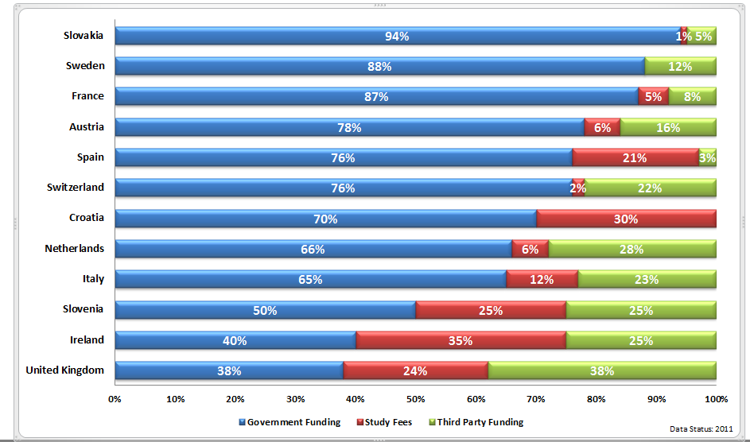
HE in general as financed by public money

Slide 6
Regulations for Studying with/without monetary support
laws
admission procedures
exemptions
special regulations (international students, handicapped students)

Slide 7
Austria 1: SSA 1992
Student Support Act 1992: students are legally eintitled to social support scheme on certain conditions
§§: any regular student entitled to apply
§§: limits: own salary, parents’ / partner’s / spouse’s salary
§§: applicable for the regular duration of curricula

Slide 8
Austria 2: Students & HEIs
approx. 150 HEIs (from 100 to 92,000 students)
largely free access to HE (public universities)
Secondary School leaving certificate
admission on short notice (almost “walk-in” basis)
legally prescribed duration: 3ys bachelor, 2 ys master

Slide 9
Austria 3:
How many SSA Grant Applicants?
some 80,000 applications (on-line) per year
some 47,000 grants awarded annually under the SSA (by “automated” follow-up application)
other special scholarship schemes (for socially needy students, for especially gifted students, for students studying abroad)

Slide 10
Austria 4:
Systemic Deficiences within the Grants System
automated application without in situ counter-checking
eligibility is checked on-line on the basis of official tax revenue income data of relatives
certificates of awards are couched in (very) bureaucratic language
Grant Awarding Authority does not have its own complaint / customer relationship management

Slide 11
Austria 5:
Systemic Deficiencies within the
HE System
at public universities: almost no entrance requirements, no entrance tests, almost no screening of candidates
overcrowded courses, classrooms in SOME disciplines (“massification2 of HE)
official confirmation of lack of infrastructure by HEIs if it is (supposedly) their fault (!)

Slide 12
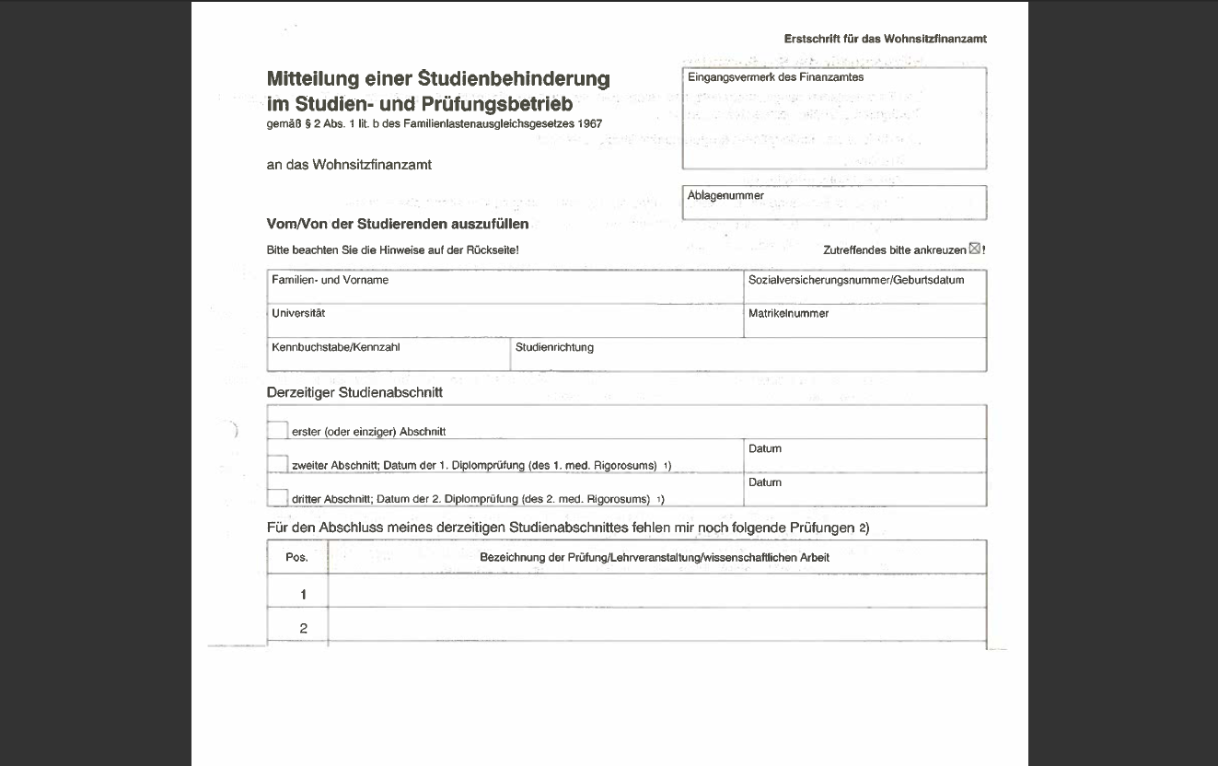

Slide 13
Ombudsman?
(wikipedia)
An ombudsman or public advocate is usually appointed by the government or by parliament, but with a significant degree of independence, who is charged with representing the interests of the public by investigating and addressing complaints of maladministration or violation of rights.

Slide 14
Austria 6:
National Higher Education Ombudsman
available to all national / international students (public / private universities, universities of applied sciences, teacher training colleges)
≈some 360,000 students nationwide
plus (first time) applicants, plus former students, plus students turned down at A and tryingf to be admitted at B
has right to investigate, institutions have duty to inform
reports in public reports to the minister, to parliament, recommendations to HEIs

Slide 15
Austria 7:
What Can the Ombudsman Do?
Empowerment by:
checking the facts (☹)
checking the procedures
checking the information given (if on written record)
checking the legal regulations / requirements
informing the student(s)
giving recommendations to the HEIs / grant awarding authorities (both are autonomous authorities)
Not legally binding!

Slide 16
Austria 8: Worst Case
student asked (forced) to pay back approx. € 8,000- “excess payment”
had gotten (unjustified) grants for several semesters: without knowing, without being told
no university confirmation of his successful progress in studying (possible), since he was a ph.D. student
student DID (HAVE to) pay back!
regulations have been changed since that

Slide 17
Empowerment
Information
on
Ombuds Services
Low threshold!
No costs!
Confidential!
Students
Conflict Resolution Procedures at HEI (if available)
Inclusion of
„vulnerable“ groups
Support by Student Union

Slide 18
Contact Details
Dr. Josef Leidenfrost, MA (Mediation)
Ombudsstelle für Studierende
Austrian Student Ombudsman
Minoritenplatz 5
A-1014 Wien / Vienna
(43-1) 53120-5533
(43-1) 53120-995533 Fax
toll free 0800-311 650
(MON-FRI 9-16h)
www.hochschulombudsmann.at
info@hochschulombudsmann.at

