Slide 1

HIGHER EDUCATION OMBUDSMEN AND EMPOWERMENT
TOWARDS EARLY RESOLUTION AND A GOOD PRACTICE FRAMEWORK
Rob Behrens
“Don’t Mourn, Mobilize” Joe Slovo
Chief Executive and
Independent Adjudicator
Robert.behrens@oiahe.org.uk
Twitter @OIAChiefExec
ENOHE ANNUAL CONFERENCE, WARSAW, POLAND
15-17 MAY 2014

Slide 2
THE OIA AS A STRATEGIC PARTNER
A Classic Ombudsman Scheme – independent complaints handler of last resort established under 2004 Higher Education Act
Applies to 141 HEIs in England and Wales – not Scotland.
With experience of 10,000 cases and (almost) universal compliance
Sensitive to special features of Higher Education (R (Mustafa) v OIA [2013] EWHC 1379)
Free to students and with a year-on-year lowering of unit costs for universities
Use of Transparency to generate scrutiny, understanding and public trust
Member of the Regulatory Partnership Group (and partner in developing the sector Operating Plan)
Engine of Good Practice

Slide 3
CONTEXT OF GOOD PRACTICE INITIATIVES
Development of oversight of universities
Rise of student complaints and appeals
Government White Paper (2011) ‘Students at the heart of the system’ reflects and accelerates rises of student expectations and assertiveness.
Evidence of variable practice and some unacceptable practice
Comparative precedents (eg Scotland).

Slide 4
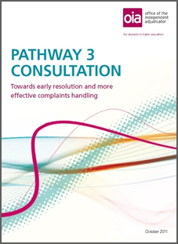
OUTWARD-FACING, PARTNERSHIP APPROACH
On-going consultation programme to develop the OIA itself and the way the sector deals with student complaints
Informs strategic and operational plans
Through:
  Question papers
  Written submissions
  Complainant survey
  Round-table meetings
  Options to choose from
  Routine, regular visits to HEIs and
  students unions
  Learning from other sectors

Slide 5
TRENDS IN COMPLAINTS AND APPEALS - COMPLAINTS RECEIVED BY THE OIA

Slide 6
WHAT IS COMPLAINED ABOUT:
2012 OUTTURNS

Slide 7
HOW THINGS GO WRONG
University failed to follow its procedures
Breaches of the duty to act fairly (natural justice)
Information not properly considered (or not demonstrated that it was)
Delay or maladministration
Non-implementation of appeal panel decision
Cohort dealt with inconsistently
Inadequate supervision/tuition/equipment
Poor communication or misinformation
Discrimination issues, especially disability

Slide 8
NEW CASE-RELATED ELEMENT IN SUBSCRIPTIONS
Core subscription continues to be determined by OIA Board in the context of complaints volumes and organisational efficiency
From 2014 case element based on ineligible, settled / withdrawn and reviewed cases from the previous year
Points based system with points allowance based on subscription bands
December 2012 letter detailing thresholds and costs-per-point above the threshold for 2013 cases
Case element invoiced in March 2014
In first year a minority of universities likely to pay the case element

Slide 9
EARLY RESOLUTION PILOTS
Campus Ombudsmen as suggested by 2011 HE White Paper ?
Diversity of existing provision
  Student Services Offices
  Students Union Advice Centres
  Student Conciliators
  Graduate Interns
  Complaint Mediation Schemes
Mediation
No “one size fits all”
Canterbury Christ Church – wider use of mediation
University of South Wales – Student Conciliators
Sheffield – facilitated discussion
Kingston – training in complaint handling and mediation
Huddersfield – student conciliators
ARC linking pilots to good practice procedure

Slide 10




TOWARDS A GOOD PRACTICE FRAMEWORK
80 per cent of Pathway 3 submissions agreed that a framework focusing on operational complaints and appeals resolution would be extremely useful.
This framework will be:
  Consultative
  Jointly developed
  Non- statutory
  A living document (web-based) and
  Complement QAA Quality Code

Slide 11
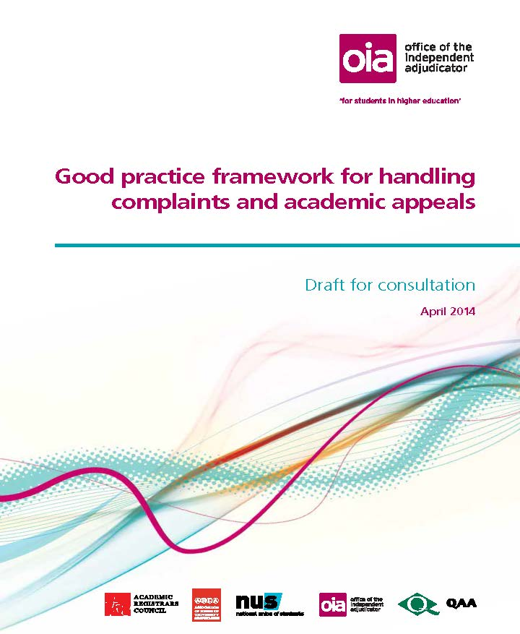
GOOD PRACTICE FRAMEWORK
THE DRAFT FRAMEWORK
KEY FEATURES
Three stage process
Inclusion of Academic Appeals as well as Complaints
Time-frames
Inclusion of Early Resolution and Conciliation
Consultation: April-July 2014
Publication: September 2014
Adoption: September 2015

Slide 12
GOOD PRACTICE FRAMEWORK:
THE EMERGING ISSUES
‘Wicked’ Issues
Importance of Comparative Analysis
Scope of Framework
Regulatory Status
Implications of Ombudsman oversight.

