Slide 1
What I Learned During My Mandate as Ombudsperson for Students
ENOHE Conference
Warsaw, Poland, May 15-17, 2014
Spencer Boudreau PhD
McGill University
Montreal, Qc
Canada

Slide 2
Situating Myself
McGill professor for 25 years
Director of Student Teaching
Associate Dean
Disciplinary Officer
Chair, University Grievance Committee

Slide 3
The Administration
Not the enemy;
Need to know who the key individuals are who have authority to decide;
Personal relationships with these individuals are always most helpful;
Present the situation while noting that this is the student’s version so as not to be accusatory;
Do not hesitate to point out a regulation that is not being respected.

Slide 4
The Staff
Often they can get things done quickly without going further up the ladder;
Again important to have good relations with key individuals;
Be patient - remember staff employees are often overworked and underpaid;
As with the administration, never be accusatory.
Nota Bene: Remember the most important staff members are the ones in your office – learn from their experience and treat them like colleagues.

Slide 5
The Students
How would you describe the students in your university or college?

Slide 6
My View
Intelligent
Determined
Critical, but lacking self-criticism
Stressed
Distracted
What does research teach us about the millennials?

Slide 7
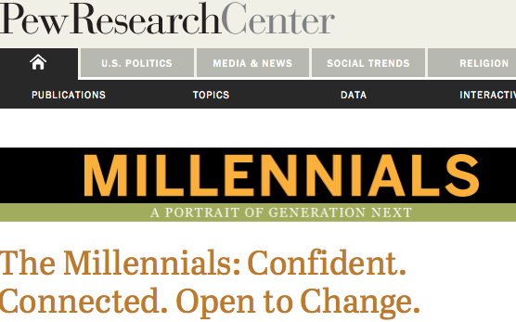
Notes:
Feb 24, 2010

Slide 8
Millennial Generation: Born after 1980. Growing up in the 21st century
They are:
relatively unattached to organized politics and religion (29% say they are not affiliated with any religion);
linked by social media (81% are on Facebook);
burdened by debt;
distrustful of people;
in no rush to marry (just 26% of this generation is married);
optimistic about the future.

Slide 9
Notes:
Narcissism is excessive self-esteem.
Methodology: over-time, meta-analyses of undergrads resp to psychological questionnaires measuring IQ, personality, attitudes, reading preferences, expectations. Also time-lag studies of nationally representative HS students

Slide 10
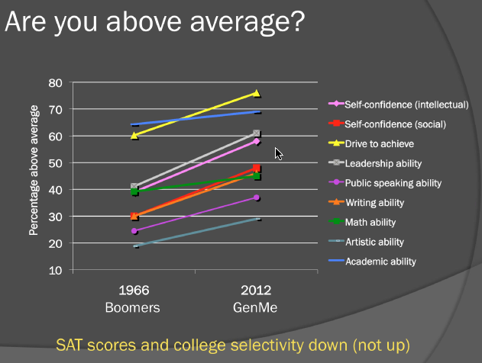
Source: Twenge (2013
(American Freshman Survey)

Slide 11
What is narcissism?
Measured by Narcissistic Personality Inventory (NPI)
Overly focused on self
Lack empathy for others (cannot take other’s perspective)
Superior and entitled
Poor work or relationship partners
More hostility, anxiety, anger
Increased in recent generations

Slide 13
Some problems that might result
Inflated sense of self (anything is possible)
Sense of entitlement
Overconfident (I am awesome and I deserve the best)
Normalize narcissism
More depression and anxiety (reality hits)

Slide 15
Dealing with Generation Me: Problem students and student problems
Entitled student
Anxious student/perfectionist
Angry student
Overconfident student who crashes
C’est la génération “Moi je pense que…”
“We are all born superstars” (Lady Gaga )
Notes:
Entitled: show empathy AND follow syllabus
Anxious: failure can be a great teacher
Angry: model calmness. Teach perspective-taking (is this the best way to react?)
Overconfident: expose the talent myth. It takes 10 years

Slide 16
According to Statistics Canada, youth aged 15-24 are the most likely to suffer the effects of mental illnesses, substance dependencies and suicide.
(State of Mind: Addressing mental health issues on university campuses in University Manager, summer 2012)
En 2012, les 18-24 ans ont été les moins heureux des Québécois, selon l’indice relatif du bonheur. (L’Actualité, Mars, 2013)

Slide 17
Generation Me: the good news
More extraverted;
Agentic traits (assertive, dominant, competitive);
Higher self-esteem;
More tolerant, less prejudiced;
Upside of individualism;
Positive-until it crosses over into narcissism.
Notes:
Narcissism is self-

Slide 18
LOUPE
Listen
Observe
Understand
Partner
Empower

Slide 19
Qualities of an Ombudsperson (according to my colleagues)
Fair-minded
Calm/good listener
Non-judgmental
Open-minded
Diplomatic
Creative
Knows the rules/how things work
Institutional memory

Slide 20
Qualities
Able to analyze complex issues
Range of experiences
Works well with others/administration
Demonstrates empathy
People person
Objectif/Pas trop de prejugés
Integrity
Ready to consult
Can leave job at work

Slide 21
References
AArnett, J. (2000). Emerging adulthood. American Psychologist, 55(5), 469-480
Hart, D. [ca. 2012]. The millennial generation and the lecture. [video file]. Retrieved from http://vimeo.com/24148123
Twenge, J. (2006). Generation me. New York: Simon & Schuster. Simon and Schuster. N.Y.
Twenge, J. (2009). Generational changes and their impact in the classroom. Medical Education, 43, 398-405.
Twenge, J. (2013, November, 6). Generation me in the classroom. In Worth Publishers’ TLC Symposium Series (online 20131106 1800-1.arf)
Twenge,J. and W. Campbell (2009). The Narcissism Epidemic. Simon and Schuster. N.Y.

Slide 22
MERCI
spencer.boudreau@mcgill.ca

