Slide 1
The first Student Ambassador in Denmark: why not “Student Ombudsperson” and why not sooner?
Tina Kaare
Student Ambassador

Slide 2
Agenda
Introduction to the Student Ambassador at the University of Copenhagen
Why not Student Ombudsperson and why not sooner?
First experiences

Slide 3
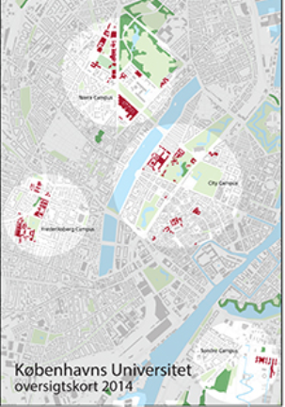
Introduction to the Student Ambassador at the University of Copenhagen
The University of Copenhagen is from 1479 and the oldest university in Denmark
Approximately 40.000 students
Approximately 4000 Ph.d. students
Is located in four campuses in different
parts of Copenhagen
The Student Ambassador at The University
of Copenhagen was the first of its kind in
Denmark and is still the only one

Slide 4
Introduction to the Student Ambassador at the University of Copenhagen
The Student Ambassador position was established on the 1 of January 2013
The Student Ambassador is independent from The University of Copenhagen, including the daily management, board, employees and students.
Students, Ph.d. students, student assistants and people who apply for a degree programme or run into problems with enrolment at The University og Copenhagen can contact the student ambassador
Students can ask the student ambassador for advice on anything pertaining to the University of Copenhagen

Slide 5
Introduction to the Student Ambassador at the University of Copenhagen
The Student Ambassador is objective but sees a case from the student’s perspective
The Student Ambassador can not make any dicisions
The Student Ambassador can provide guidance on and handle complaints for students
The Student Ambassador can enter into a dialogue with for example a faculty
The Student Ambassador can initiate investigations of the administration’s handling af specific case areas and draw up reports
The Student Ambassador can provide guidance, advice and teaching to employees and students

Slide 6
Agenda
Introduction to the Student Ambassador at the University of Copenhagen
Why not Student Ombudsperson and why not sooner?
First experiences

Slide 7
Why not Student Ombudsperson and why not sooner?
The Milena Penkowa case.
Milena Penkowa was a researcher at The University of Copenhagen, who was caught in scientific fraud and who falsely accused a student for stealing. As a follow up on the Penkowa case rektor proposed five initiatives and among them that The University of Copenhagen should have a student ombudsman.

Slide 8
Why not Student Ombudsperson and why not sooner?
The Student Ambassador was originally to have been a Student Ombudsperson
Ombudsperson, a protected title
The Legal affairs Commitee in The Danish Parliament did not give the permission for the use of the title
Regardless of the title, the students are aware of, what The Student Ambassador can be used to

Slide 9
Agenda
Introduction to the Student Ambassador at the University of Copenhagen
Why not Student Ombudsperson and why not sooner?
First experiences

Slide 10
First experiences
Website
Flyer
Phone
Facebook
Dialogue meetings with faculty staff, student organizations, student councellors
Statistical system
Study starts events
Student Fair
Exchange of experiences with the Student Ombudsperson for The University of Oslo
Participation in a forum for costumer ambassadors from various public and private companies in Copenhagen

Slide 11
First experiences
132 inquiries the first year and increasing during the year
Most inquiries from The Faculty of Law followed by The Faculty of Humanities and The Faculty of Health
Most students contact The Student Ambassador by e-mail
The students turn to The Student Ambassador with a large variety of questions
The Student ambassador gets a lot of positive feedback from students, who have been in contact with the function

Slide 12
First experiences
The students feel alone in the meeting with a very large system
The University could benefit from being more dialogue-based
The University's administrative practices that lead to the student being delayed
Short and standardized dicisions
Various errors in the proceedings
The tone – there are many ways to say the same

Slide 13
First experiences

Slide 14
The first Student Ambassador in Denmark: why not “Student Ombudsperson” and why not sooner?
_{QUESTIONS?}
_{COMMENTS?}

Slide 15
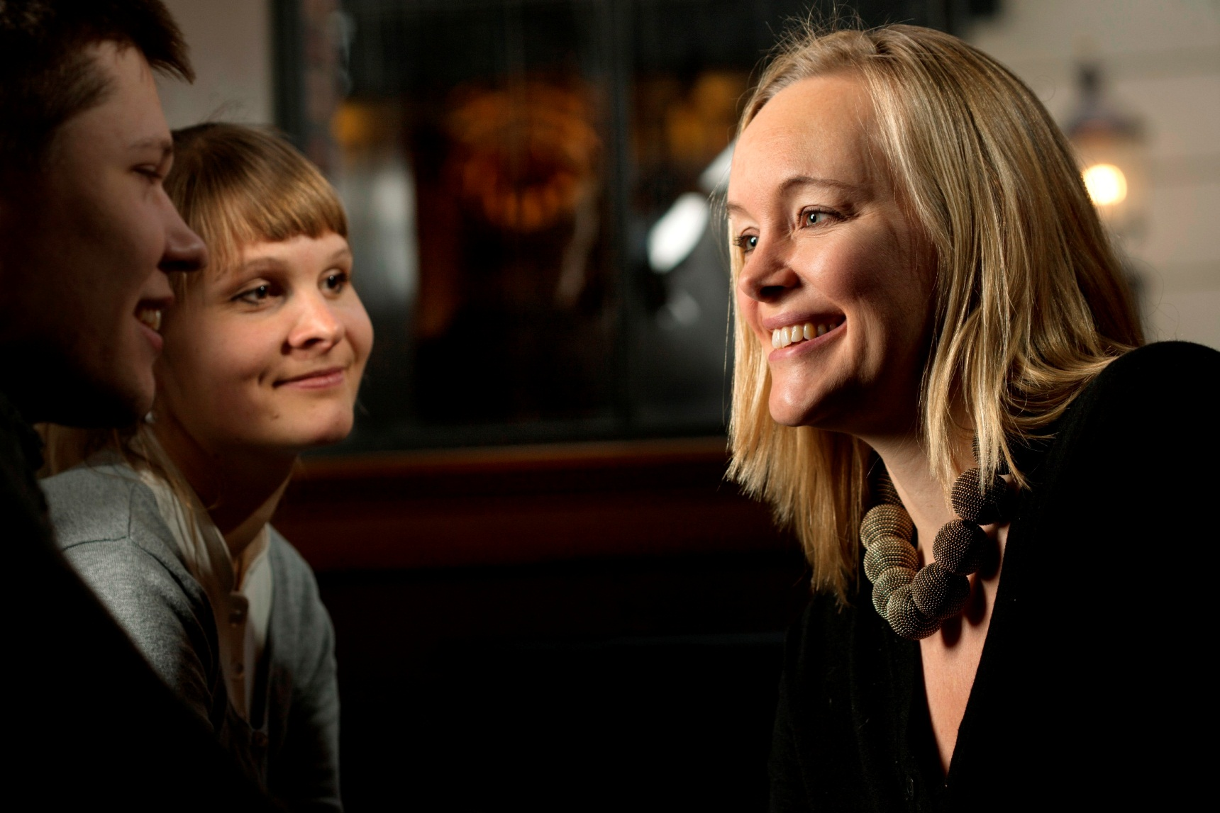
The Student Ambassador
Fiolstræde 1
1171 København K
Phone: 35 32 28 13 eller 23 80 79 96
E-mail: studambassador@adm.ku.dk
Office hours: Tuesday between 12.00-15.00 or by appointment
www.studenterambassadoer.ku.dk
Facebook.com/studenterambassadoer

